Slide 1
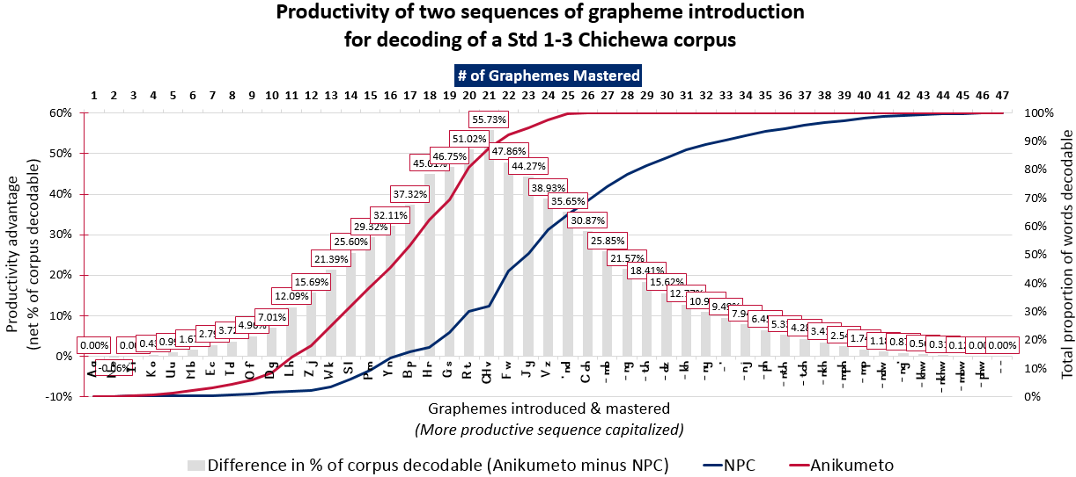
Early Grade Reading Activity
Analysis of a corpus of Chichewa Std 1-3 texts using SIL’s SynPhony Software
December 1, 2015
USAID|Malawi Offices
Notes:
[Welcome comments]
The purpose of this presentation is to describe an approach that can be taken to identifying a “maximally productive” sequence of grapheme introduction.
The presentation is intended to spur discussion and mutual exploration, NOT to issue a definitive ruling on what “the best” sequence is. However, we believe that if all parties understand the approach and see it as useful and valid, that can greatly facilitate and accelerate the process of developing high-quality teaching and learning materials.

Slide 2

Roadmap of the Presentation
Need for the analysis (5)
Ministry of Education, Science, and Technology (MoEST) National Reading Strategy (NRS) expectation
Analytical process (7)
The tool
Selecting the inputs
Mechanics of the analysis
Reading the outputs
Results (17)
Approaches to interpreting the output
Findings
Implications (4)
Notes:
The first four slides present why we felt the analysis was necessary.
The next seven slides describe the tool and analytical approach that we used.
The following seventeen slides take one set of results and use them to illustrate the various ways we can think about and visualize the analysis output.
Then there is a 10-minute period during which you (the audience) can explore the data in real-time as you see fit.
Finally, we spend four slides discussing the findings and what we think the implications may be.

Slide 3
Need for the Analysis (1)
“It is not necessary for children to learn all the letter sound correspondences before they learn to read words. Once children have acquired some letter or syllable/sound correspondences, they can begin to blend these to read words. That is why the introduction of letters in a productive sequence, a sequence that includes both vowels and consonants is recommended. As children add symbol/sound correspondences to their alphabetic schema, the number of words they will be able to read will increase.”
Malawi National Reading Strategy (2014-2019), p. 11
– Ministry of Education, Science, and Technology
Notes:
As you know, the National Reading Strategy takes a phonics-based approach to reading instruction.
If that is your theoretical framework, you want to get children decoding real words – words that are familiar to them already as part of their oral vocabulary – as soon as possible, as this helps concretize the link between symbols on a page and sounds that they hear.

Slide 4
Need for the Analysis (2)
“Further, to ensure that children develop appropriate skills over time a four-year scope and sequence of skills will be developed that maps out all the skills and competencies that are expected in Standards 1-4. For the phonics strand, a productive sequence of letters will be used to ensure that children can begin to blend letters into words within the first two weeks of beginning reading instruction in standard 1. The mapping of letters as well as other relevant linguistic elements will continue until all have been included.
Malawi National Reading Strategy (2014-2019), p. 17
– Ministry of Education, Science, and Technology
Notes:
As the NRS also states, the goal is to get children reading within the first two weeks of school. While ambitious, that is eminently do-able given the proper sequence of grapheme introduction.
Further, the NRS is clear that all graphemes and relevant linguistic elements must be taught. So there is no question about only teaching some and then leaving others aside; all graphemes and relevant linguistic elements will be presented. It’s merely a matter of choosing the best sequence to present them in.

Slide 5
Need for the Analysis (3)
“Furthermore, there is no agreed upon order in which to introduce the letter-sound relationships. It is generally agreed, however, that the earliest relationships introduced should be those that enable children to begin reading words as soon as possible. That is, the relationships chosen should have high utility.”
The Alphabetic Principle
–Texas Education Agency
Notes:
Now, the correct order will vary from language to language. The most appropriate sequence in English may not (will likely not) be the most appropriate sequence for Chichewa, or Kiswahili, or any other language.
The key is that the sequence gets children reading early; the earlier they are able to make the connection between written symbols, sounds, and the vocabulary they already know, the sooner the everyday writing around them – signs, posters, wrappers, food containers, billboards, etc. – becomes a source of practice and reinforcement.
Early acquisition of basic decoding skills creates the possibility for a virtuous cycle, and that’s what we are aiming for.

Slide 6
Need for the Analysis (4)
TLMs in Malawi include at least 3 approaches:
Alphabetical:
“NPC”:
“Anikumeto”:
a b ch d e f g h i j k l m n o p r s t u v w y z
Std 1: | a e i o u b d f g h j k l m n p r s t v w y z ch bw dw dy dz gw kh | (30)
Std 2: | kw mb mf mg mk ml mp ms mt mv mw mz nd ng ng’ nj ns ny nz ph ps pw sh sw th ts khw mph ndw nkh nth ngw nkhw ntch nsw tch thw | (37)
Std 1: | a n i k u m e t o d nd l z dz nz w kw s ts p mp y ny b bw h kh g ng r th ch f mb j nj v ph dw gw ml ns fw mk mt mv ps pw bz | (49)
Notes:
We know of at least 3 approaches – it’s possible that Read Malawi or Literacy Boost or some other intervention has used a different approach. If so, we would be happy to incorporate those other sequences into future analyses.
In the case of the “Alphabetical” approach, the letter “c” – which does not appear on its own in Chichewa – has been replaced by the digraph “ch”.

Slide 7
Need for the Analysis (5)
Which sequence of introduction will be maximally effective?
“Maximally effective” = children are reading most rapidly
Notes:
Again, the fundamental research question we want to try to answer is, “Which sequence of introduction will be maximally effective?” And our assumption is that “maximally effective” means “children read soonest”.

Slide 8
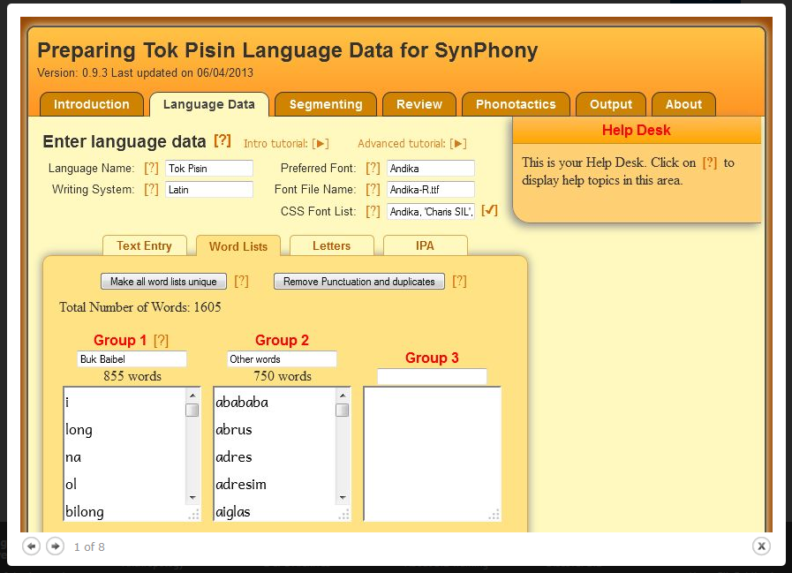
Analytical Process: the Tool
SIL International’s
SynPhony software
Core functions:
Creating word lists according
to user-defined criteria
Checking texts against
defined lists of items introduced to verify suitability for use at a
particular point in the curriculum
Notes:
The software we used was developed by the Summer Institute of Linguistics (SIL) and is known as “SynPhony”.
SynPhony is a piece of software that lets reading instructors, teachers, curriculum developers, or anyone else develop or select reading materials, classroom aids, etc. on the basis of defined criteria.
For instance, a teacher could think, “I want to develop a list of all the words my learners might be able to read if they have learned the letters A, B, M, and O.” She would then select those letters, and SynPhony would analyze the corpus of words it has been provided in order to generate a list of words that contain only those letters.
In another functional mode, SynPhony displays an existing narrative text. The user then selects certain letters that the learners have mastered to date, and the software highlights which words (and thus how much of the overall narrative) the learners will be able to decode and/or access. The teacher would then be able to know whether that particular story is appropriate for use in, say, Week 4 of the course, or Week 8 of the course, or Week 12 of the course.

Slide 9
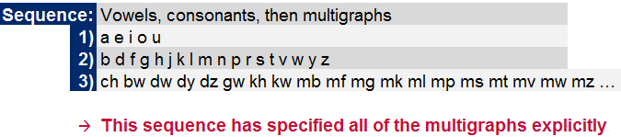
Analytical Process: Selecting the Inputs (1)
Inputs required:
Unformatted text from a representative corpus
Parameters for treatment of multigraphs
Desired sequence(s) of grapheme introduction (optional)
Notes:
The quality of SynPhony’s analysis is dependent on the inputs or parameters that the users provide. The most critical element is a large corpus of words – the larger, the better, with the caveat that the text should be generally at the level of the learners.
The next element is guidance as to how SynPhony should treat multigraphs (which we’ll talk about in a moment).
Finally, the user can either choose to provide a specific sequence of grapheme introduction or allow SynPhony to suggest one.

Slide 10
Analytical Process: Selecting the Inputs (2)
Graphemes are written representations of phonemes (individual letter sounds)
A multigraph is a combination of letters which represent a single phoneme or blend. Chichewa examples include
kw, mb, mg, ng, ng’, nkhw, ntch, tch, nz, ph, ps, sh, khw, mph, ndw, nkh, nth, ngw
SynPhony can treat multigraphs as decodable either
…once their component letters have been introduced
…once the multigraphs have been explicitly introduced†
Phoneme | English Grapheme(s) | Chichewa Grapheme(s)
/b/ | b | b
/k/ | k, c, cc, ck, ch | k
Notes:
† Discuss “SH” – if you don’t tell SynPhony to treat it “explicitly”, then SynPhony assumes that “SH” is decodable as soon as you know “S” (/s/) and “H” (/h/), which we know is inaccurate.

Slide 11
Analytical Process: Selecting the Inputs (3)
Sequences provided as inputs†:
Alphabetical:
NPC:
NPC-Explicit:
Sequences generated by SynPhony:
SynPhony:
SynPhony-Explicit:
a b ch d e f g h i j k l m n o p r s t u v w y z
a e i o u b c d f g h j k l m n p q r s t v w y z
a e i o u
b d f g h j k l m n p r s t v w y z
ch bw dw dy dz gw kh kw mb mf mg mk ml mp ms mt mv mw mz nd ng ng’ nj ns ny nz ph ps pw sh sw th ts khw mph ndw nkh nth ngw nkhw ntch nsw tch thw
a n i k u m e t o d l z w s p y b h g r ch f j v
a b w n o m k u d l i z e s t y r p h g ch f v j ’ c
a b w n o k m u l i d t s e p z r y
nd ch mb f ng g th dz kh v ny ’ nj ph j nth h tch nkh mph mp ndw ng’ khw nkhw mbw c phw
Notes:
Alphabetical:
C → CH No “Q” No “X”
NPC:
Vowels, consonants (No “X”)
†Anikumeto was analyzed, but the multigraphs weren’t explicitly declared. So we intend to re-run the analysis to see how it compares in an apples-to-apples comparison. (Right now, the current analysis would be inappropriately biased in favor of Anikumeto.)
SynPhony:
Differences between the “SynPhony” and the “SynPhony-Explicit” sequence (abwnomk / abwnokm) are intentional, not typos.

Slide 12

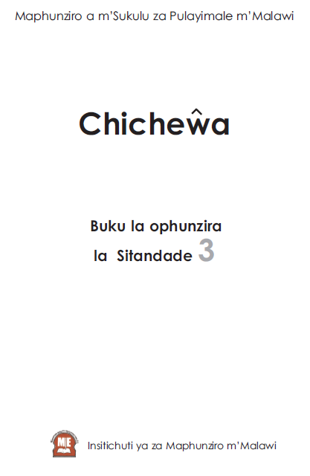

Analytical Process: Selecting the Inputs (4)
Text Inputs provided:
Nditha Kuwerenga
Std 1 Chichewa
Learner Book
Std 2 Chichewa
Learner Book
Std 3 Chichewa
Learner Book
Characteristics of
the corpus:
3190 words (1613 unique)
Syllable length ranged from 1-8
Notes:
The texts that we included in the corpus that SynPhony analyzed included the Standard 1-3 NPC learner’s books for Chichewa and the Nditha Kuwerenga learner’s book.
In our case, these textbooks yielded 3,190 words – but only 1613 of them were unique. (In other words, some of the 1613 words showed up once, others twice, others thrice or more…eventually giving a total of 3,190.)

Slide 13
Analytical Process: Mechanics of the Analysis
SynPhony processes the inputs (multigraph rules, input sequences, and corpus) and produces the following:
A list of word frequencies
A list of letter frequencies
A productivity table
Notes:
These are the products of the SynPhony analysis:
A list of words found in the corpus, and how often each word appeared;
A list of letters found in the corpus, and how often each letter appeared;
A table that analyzes the above to describe how “productive” each sequence is.

Slide 14
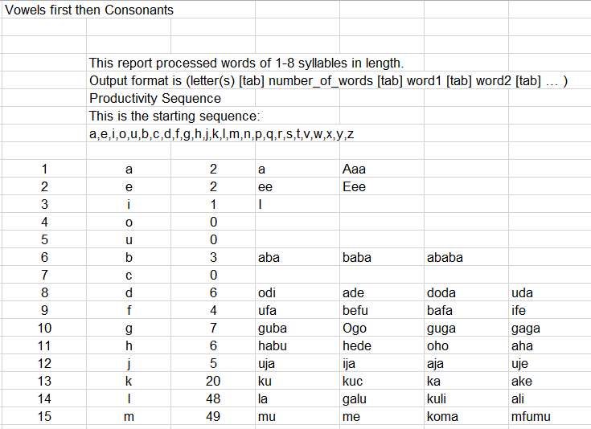
Analytical Process: Reading the Outputs
(1) Sequence
(2) Grapheme #
(3) Latest Grapheme added
1
(4) # of add’l words rendered decodable
2
3
4
(5) List of add’l words rendered decodable
5
Notes:
This is what the raw output looks like:
Is the sequence in which SynPhony introduced the graphemes
Is the # (position) of the grapheme being introduced
Is the actual grapheme introduced
Is the number of additional words “unlocked” (rendered decodable) by the addition of that grapheme
Is the list of specific words that became decodable (and were counted under #4)

Slide 15
Results: Approaches to Interpretation (1)
Finding the “maximally effective” sequence requires comparisons – but which?
Possible metrics:
Number (#) of unique words decodable
Proportion (%) of unique words decodable
Proportion (%) of total corpus decodable
Fundamental comparison: net difference in [metric] using sequence A vs. sequence B.
Notes:
Our goal is to figure out which of the various sequences is maximally effective in getting children to read – but there are various ways to interpret the results.
The first looks at how many of the 1613 unique words in our corpus are decodable;
The second looks at the proportion of the 1613 unique words in our corpus that is decodable;
The third looks at the proportion of all of the 3,190 total words in the corpus that is decodable.
In each instance, the fundamental question is whether there is a difference between two sequences, and if so, how large it is.
We will apply each of these three approaches in turn; these next few slides will introduce how to read the graphs.

Slide 16
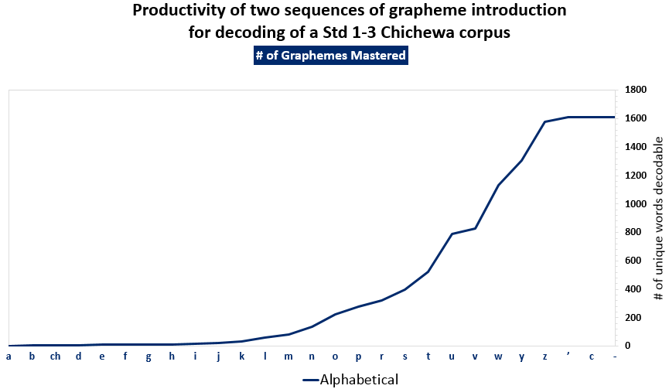
Results: How to read the basic results graphs (1)
Method A: # of unique words decodable
Notes:
This is a graph of the number of unique words decodable when letters are introduced in alphabetical order.
Note that the letters are displayed along the bottom of the graph – the slope of the curve begins to increase substantially around the letter “N”.

Slide 17
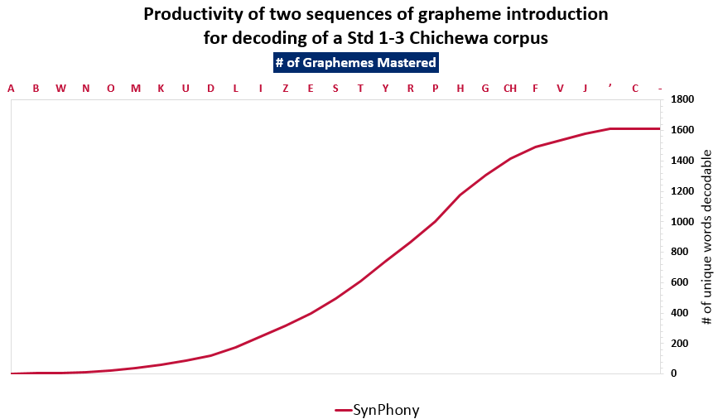
Results: How to read the basic results graphs (2)
Method A: Raw # of words decodable
Notes:
This is a graph of the number of unique words decodable when letters are introduced in a sequence that SynPhony generated automatically based on its analysis of the corpus.
Note that the letters are displayed along the top of the graph – the slope of the curve begins to increase substantially around the letter “D”.

Slide 18
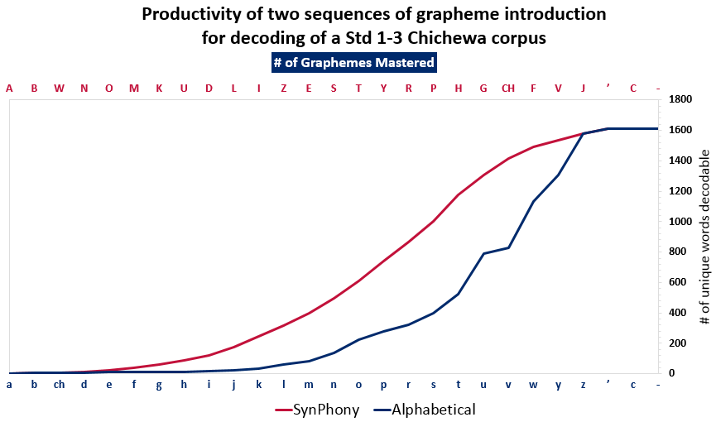
Results: How to read the basic results graphs (3)
Method A: Raw # of words decodable
Notes:
This graph superimposes the two lines on the same graph. As you can tell, there is a significant difference between the two lines, with the slope of the red line increasing more rapidly after introducing fewer graphemes.
So how big is the difference? It can be useful to look at it at certain key points in our instructional calendar – for instance, what happens if we look at the number of graphemes that will have been introduced after one term of instruction?

Slide 19
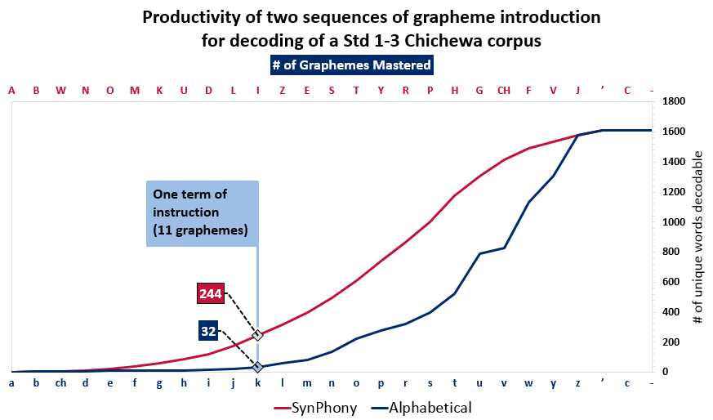
Results: How to read the basic results graphs (4)
Method A: Raw # of words decodable
Notes:
Per our calendar, you can generally expect to teach 11 graphemes within the first academic term of Std 1. So at 11 graphemes introduced, how large is the productivity gap?
A child who has been introduced to and subsequently mastered the first 11 graphemes introduced by the Alphabetical sequence – so A, B, CH, D, E, F, G, H, I, J, K – would be able to decode 32 of the 1613 words in the corpus of Std 1-3 learner books we examined.
A child who has been introduced to and subsequently mastered the first 11 graphemes introduced by the SynPhony sequence – so A, B, W, N, O, M, K, U, D, L, I – would be able to decode 244 of the 1613 words in the corpus of Std 1-3 learner books we examined.
That is a tremendous gap – 212 words! You can see how being able to read nearly 8 times as many words – 244 vs. 32 – by the same point in time would be a tremendous advantage to a child.
This was a very simple way of visualizing the data. Now we’ll walk you through the elements of a more complicated visualization, with the goal of enabling you to see exactly how many words’ difference exists at any given point.

Slide 20
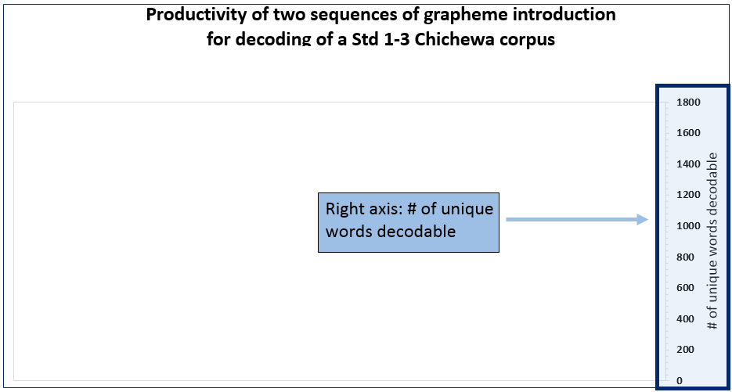
Results: How to read the more complex graphs (1)
Notes:
In these more complex graphs, the number of unique words decodable will be read against the right axis; the range will be from 0 to 1613.

Slide 21
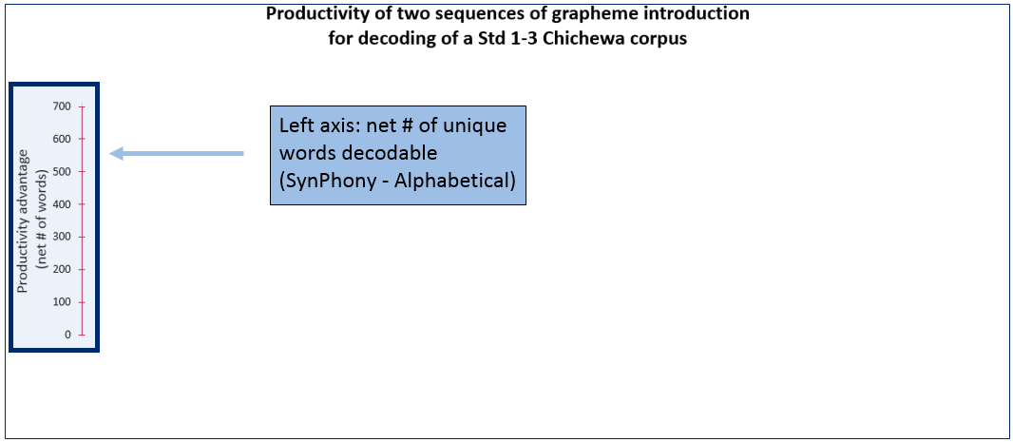
Results: How to read the more complex graphs (2)
Notes:
In these more complex graphs, the productivity advantage – the gap between the two sequences – will be read against the left axis; the range will be from 0 to roughly 700.

Slide 22
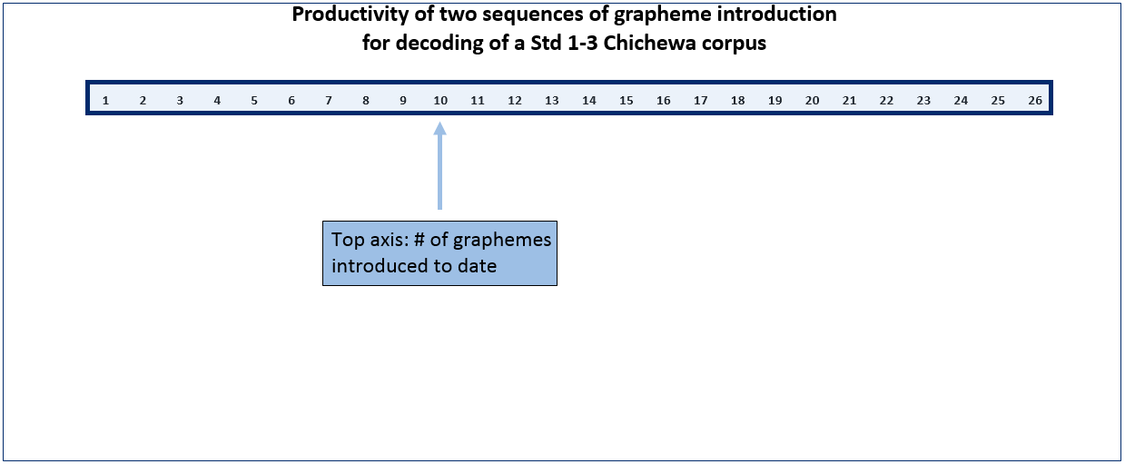
Results: How to read the more complex graphs (3)
Notes:
In these more complex graphs, the # of graphemes introduced so far – so the first, second, third; tenth, eleventh, twelfth; etc. – can be read using the top axis.

Slide 23
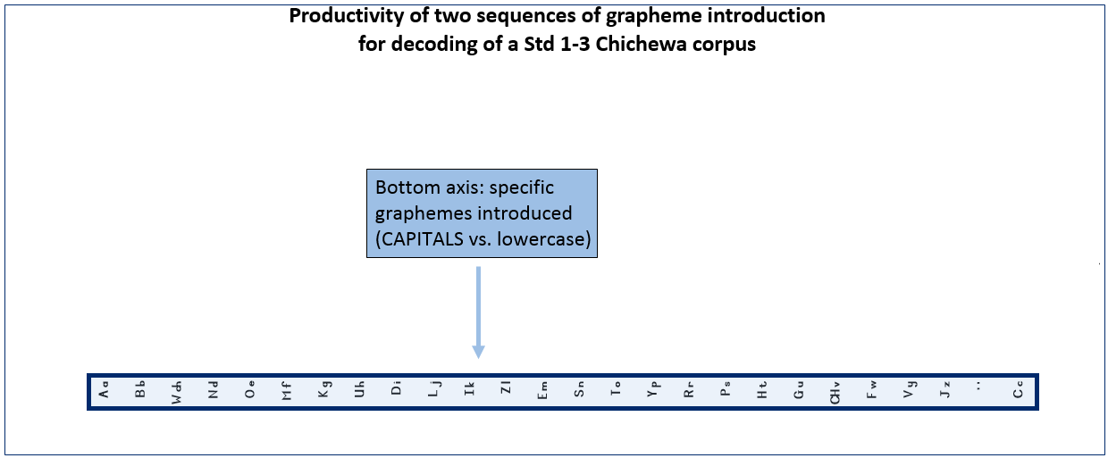
Results: How to read the more complex graphs (4)
Notes:
In these more complex graphs, the two sequences of graphemes are presented side-by-side along the bottom axis. The “more productive” sequence, which will be represented by the red line, has its graphemes listed in capital letters. The “less productive” sequence, which will be represented by the blue line, has its graphemes listed in lowercase letters.

Slide 24
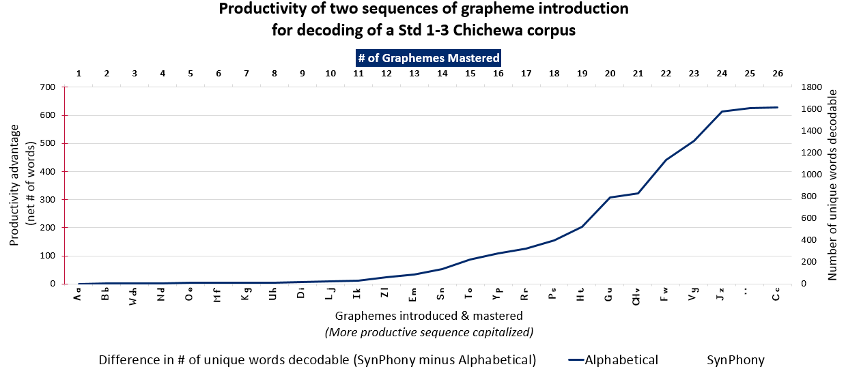
Results: How to read the more complex graphs (5)
Notes:
So, once again – here is the productivity of the “Alphabetical” sequence.

Slide 25
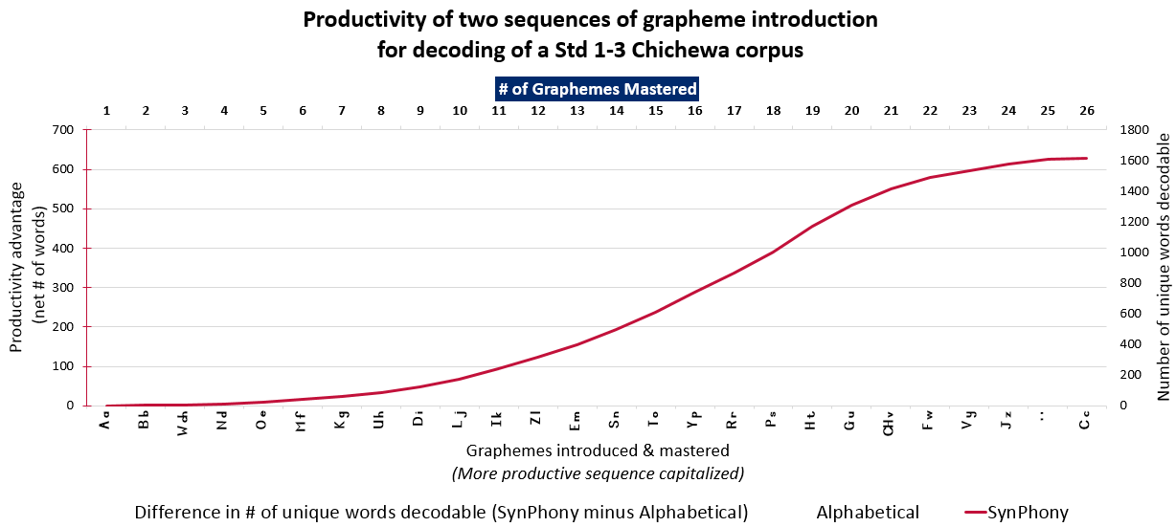
Results: How to read the more complex graphs (6)
Notes:
…and here is the productivity of the SynPhony sequence.

Slide 26
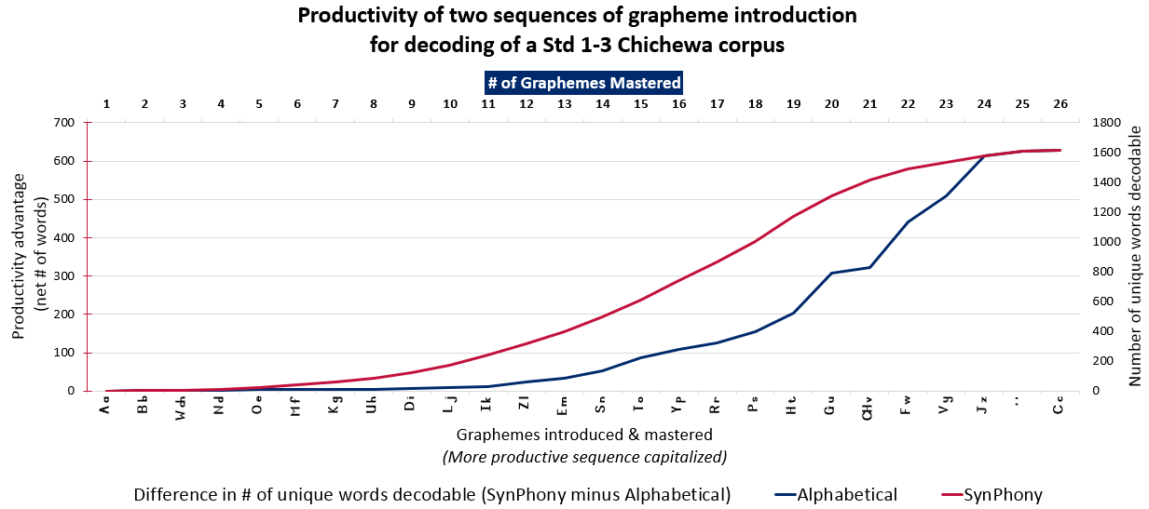
Results: How to read the more complex graphs (7)
Notes:
Here they are, once again superimposed upon each other. So far, we read everything against the right graph.

Slide 27
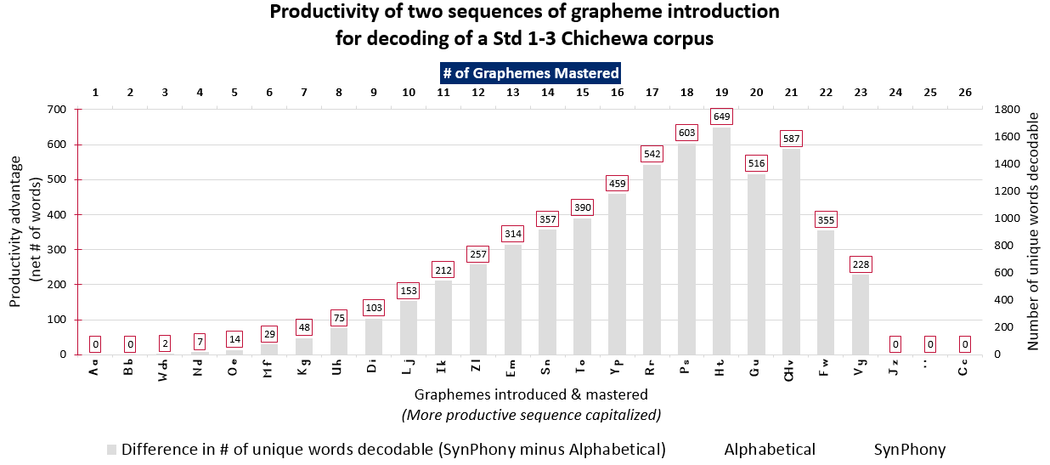
Results: How to read the more complex graphs (8)
Notes:
Now, here we have the productivity advantage, displayed for each marginal grapheme. You can see that this is read against the left axis.
Next, we’ll overlay the last graph with this graph.

Slide 28
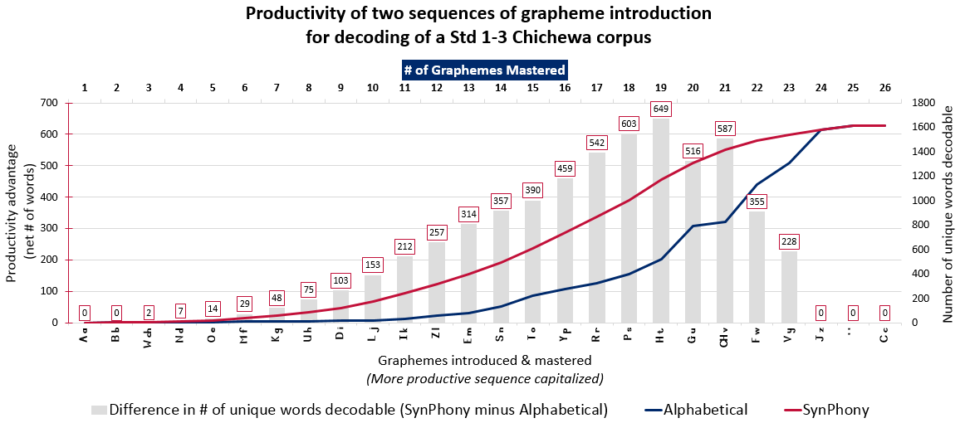
Results: Approaches to Interpretation (2)
Method A: Unique # of words decodable
Notes:
Here you go. This graph just combines the two we’ve seen before – you can now see it all in one place.
Again, so far all of these examples have focused on the number of unique words decodable. So it’s looking at 1613 words.

Slide 29
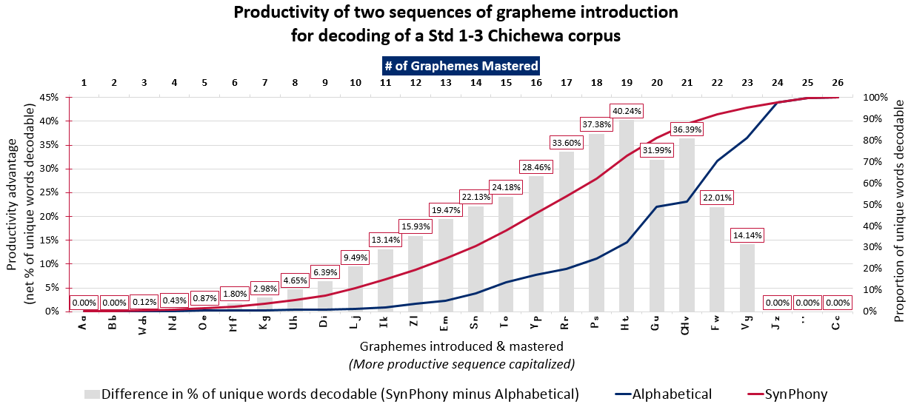
Results: Approaches to Interpretation (3)
Method B: % of unique words decodable
Notes:
This is a slightly different spin on the previous graph; the difference is that it presents both the line graphs and the bar graph in percentage terms.
The total number of words being analyzes is still 1613, because we’re still just looking at unique words.

Slide 30
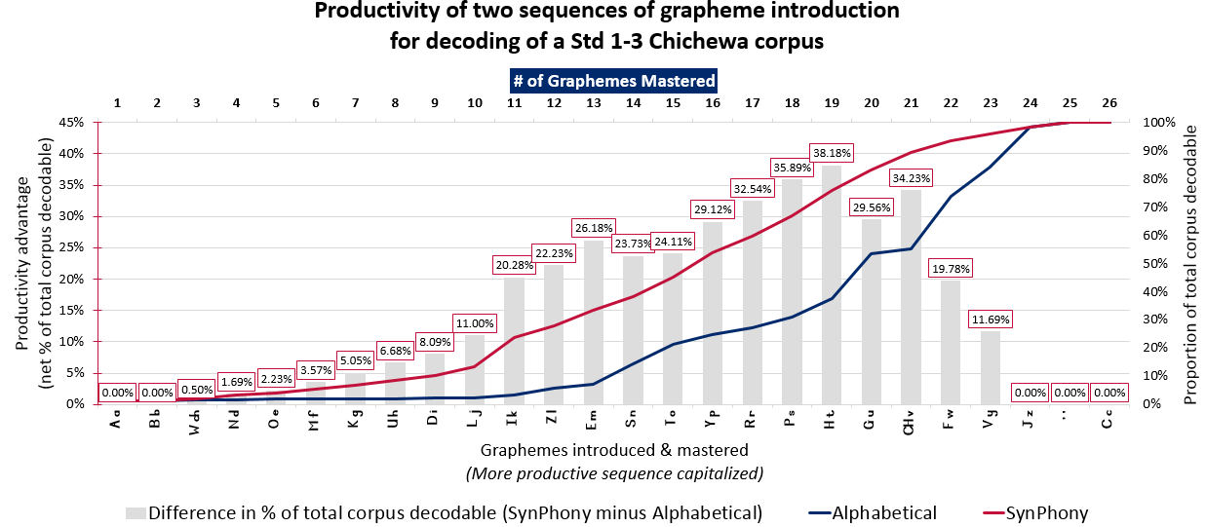
Results: Approaches to Interpretation (4)
Method C: % of total corpus decodable
Notes:
Finally, this is a presentation of the percentage of the entire corpus that is decodable. That is, rather than looking at the 1613 unique words, it’s looking at the 3190 words.
This means that if a particular grapheme allows you to “unlock” or decode a word that shows up 20 times in the corpus, that grapheme would be considered more valuable than a grapheme that allows you to decode a word that only shows up once.

Slide 31
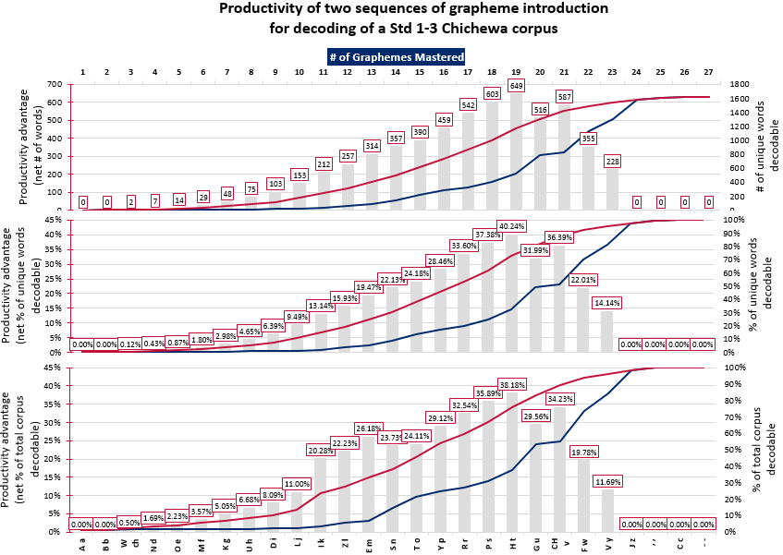
Results: Approaches to Interpretation (5)
Notes:
This slide just shows all three graphs side-by-side; the take-home message here is that the method of analysis doesn’t substantially affect the outcome. There are still significant gaps between the productivity of the two approaches, and the profiles or shapes of the graphs are all very similar.
Note that the third method, which looks at the percentage of the total corpus decodable, would likely look very different if the corpus were significantly larger or contained more repeated words.

Slide 32
Results: 10 minutes to explore
Spend 10 minutes exploring data
Notes:
Now is our opportunity to explore the data. We have a spreadsheet available right here that will enable us to select between the various comparisons available to us.

Slide 33
Results: General Findings & Caveats
General Findings
Requiring multigraphs to be taught explicitly “delays” decodability (as defined by SynPhony).†
The take-home message varies little by comparison method.
All sequences will eventually yield full “decodability.” ‡
Caveats
SynPhony cannot resolve disagreements about proper treatment of multigraphs; it only illustrates the implications of choices made during configuration.
SynPhony’s word lists are indifferent regarding word “quality.”
Notes:
So, what have we learned from these analyses?
Specifying that multigraphs be taught explicitly “delays” decodability as defined by SynPhony.
That said, it may very well be a good idea to teach (or reinforce) various multigraphs explicitly just to make sure children are very comfortable with them and have mastered them.
The take-home message – at least given the corpus we currently have – does not vary much as a function of the analytical approach you prefer (unique words vs. proportion of unique words vs. proportion of the corpus).
Assuming a fully-decodable language – which Chichewa is close to being, and English is manifestly not – eventually, all of the sequences will get you to the Promised Land. It’s just that some will give you much more practice along the way.
† Pace isn’t everything. There may be technical reasons for preferring to teach multigraphs explicitly – especially digraphs. (Maybe less so for blends.)
‡ To the extent the transparency of the orthography permits, of course. English will never be 100% decodable; Chichewa gets close.

Slide 34
Results: Specific Findings (1)
Regardless of comparison method, the SynPhony sequence is the most productive
Differences between the SynPhony and Anikumeto sequences are marginal:
Range: +55 words in favor of SynPhony to +21 words in favor of Anikumeto
Range: +3% unique words in favor of SynPhony to +2% unique words in favor of Anikumeto
Range: +3% of total corpus in favor of SynPhony to +1% of total corpus in favor of Anikumeto
Notes:
† There are [11] graphemes taught in a single term.
THIS SLIDE TO BE DELETED FROM VERSION PRESENTED TO MOEST.

Slide 35
Results: Specific Findings (2)
Differences between the SynPhony and NPC sequences are substantial:
After 5 graphemes, Method A (“# of total words” approach) shows +19 words using SynPhony; largest excess in favor of SynPhony is +899 at 21 graphemes†
After 5 graphemes, Method B (“% of unique words” approach) shows +3% unique words using SynPhony; largest excess in favor of SynPhony is +55% at 21 graphemes
After 5 graphemes, Method C (“% of total corpus” approach) shows effectively no difference between the sequences (+1% SynPhony); however, the difference grows rapidly thereafter, peaking at +56% in favor of SynPhony at 21 graphemes
Notes:
† There are 11 graphemes taught in a single term; by the end of Term 2 there are 23 graphemes. So end-of-term comparisons are as follows:
SynPhony NPC Net
Term 1 A: 244 A: 31 A: +213 SynPhony
B: 15.1% B: 1.9% B: +13.2% SynPhony
C: 23.6% C: 3.0% C: +20.6% SynPhony
Term 2 A: 1536 A: 815 A: +721 SynPhony
B: 87.8% B: 32.1% B: +55.8% SynPhony
C: 96.1% C: 53.0% C: +43.1% SynPhony

Slide 36
Implications: To Discuss
Do these findings suggest a particular course of action?
What further investigations, if any, might be warranted by these findings?
Other (??)

